Slide 1

University Institute of Engineering
DEPARTMENT OF COMPUTER SCIENCE & ENGINEERING
Bachelor of Engineering (Computer Science & Engineering)
Subject Name :Machine Learning
Subject Code: CST-316
Topic: Linear_Regression
Lecture-1.5
By : Baljeet Kaur Nagra
DISCOVER . LEARN . EMPOWER

Slide 2
Course Outcomes
CO-1:Apply the basic concept of Machine learning and statistics learning to deal with real-life Problems.
CO-2: Understand different machine learning algorithms, as well as underlying theories the behind them.
CO-3: Select and apply the appropriate machine learning algorithm to solve problems of moderate complexity
CO-4: Interpret and evaluate models generated from data.
CO-5: Optimize the models learned and report on the expected accuracy that can be attained by applying the algorithms to a real-world problem.

Slide 3
Course Objectives
To understand the history and development of Machine Learning.
To provide a comprehensive foundation to Machine Learning and Optimization methodology with applications t.
To study learning processes: supervised and unsupervised, deterministic and statistical knowledge of Machine learners, and ensemble learning
To understand modern techniques and practical trends of Machine learning.

Slide 4
Syllabus
UNIT-I
Chapter-3
Supervised Learning with Regression and Classification techniques -1: Linear Regression, Multiple Regression, Bias-Variance Dichotomy, Model Validation Approaches, Evaluation of the performance of an algorithm: Mean Squared Error, Root Mean Squared Error.

Slide 5
CONTENTS
Linear Regression
Uses
Types
Occam Razor
Simple Linear Regression
Formula
RSS
Numerical
Multiple Linear Regression
Logistic Regression
Model and types

Slide 6
Linear Regression
Linear regression is a basic and commonly used type of predictive analysis.
The overall idea of regression is to examine two things:
does a set of predictor variables do a good job in predicting an outcome (dependent) variable?
Which variables in particular are significant predictors of the outcome variable, and in what way do they–indicated by the magnitude and sign of the beta estimates–impact the outcome variable?

Slide 7
Linear Regression
These regression estimates are used to explain the relationship between one dependent variable and one or more independent variables.
Naming the Variables. There are many names for a regression’s dependent variable. It may be called an outcome variable, criterion variable, endogenous variable, or regressand.
The independent variables can be called exogenous variables, predictor variables, or regressors.

Slide 8
Uses of Linear Regression
Three major uses for regression analysis are (1) determining the strength of predictors, (2) forecasting an effect, and (3) trend forecasting.
First, the regression might be used to identify the strength of the effect that the independent variable(s) have on a dependent variable. Typical questions are what is the strength of relationship between dose and effect, sales and marketing spending, or age and income.
Second, it can be used to forecast effects or impact of changes. That is, the regression analysis helps us to understand how much the dependent variable changes with a change in one or more independent variables. A typical question is, “how much additional sales income do I get for each additional $1000 spent on marketing?”
Third, regression analysis predicts trends and future values. The regression analysis can be used to get point estimates. A typical question is, “what will the price of gold be in 6 months?”

Slide 9
Types of Linear Regression
Simple linear regression 1 dependent variable (interval or ratio), 1 independent variable (interval or ratio or dichotomous)
Multiple linear regression 1 dependent variable (interval or ratio) , 2+ independent variables (interval or ratio or dichotomous)
Logistic regression 1 dependent variable (dichotomous), 2+ independent variable(s) (interval or ratio or dichotomous)
Ordinal regression 1 dependent variable (ordinal), 1+ independent variable(s) (nominal or dichotomous)
Multinomial regression 1 dependent variable (nominal), 1+ independent variable(s) (interval or ratio or dichotomous)
Discriminant analysis 1 dependent variable (nominal), 1+ independent variable(s) (interval or ratio)

Slide 10
Occam’s Razor
When selecting the model for the analysis, an important consideration is model fitting.
Adding independent variables to a linear regression model will always increase the explained variance of the model (typically expressed as R²).
However, overfitting can occur by adding too many variables to the model, which reduces model generalizability.
Occam’s razor describes the problem extremely well – a simple model is usually preferable to a more complex model.
Statistically, if a model includes a large number of variables, some of the variables will be statistically significant due to chance alone.

Slide 11
Simple Linear Regression
Linear regression models are used to show or predict the relationship between two variables or factors.
The factor that is being predicted (the factor that the equation solves for) is called the dependent variable.
The factors that are used to predict the value of the dependent variable are called the independent variables.
In linear regression, each observation consists of two values.
One value is for the dependent variable and one value is for the independent variable.
In this simple model, a straight line approximates the relationship between the dependent variable and the independent variable

Slide 12
Formula for Simple Linear Regression
The two factors that are involved in simple linear regression analysis are designated x and y.
The equation that describes how y is related to x is known as the regression model.
The simple linear regression model is represented by:
y = β₀ +β₁x+ε
The linear regression model contains an error term that is represented by ε.
The error term is used to account for the variability in y that cannot be explained by the linear relationship between x and y.
If ε were not present, that would mean that knowing x would provide enough information to determine the value of y.

Slide 13
Formula for Simple Linear Regression
There also parameters that represent the population being studied.
These parameters of the model are represented by β₀ and β₁.
The simple linear regression equation is graphed as a straight line, where:
β₀ is the y-intercept of the regression line.
β₁ is the slope.
Ε(y) is the mean or expected value of y for a given value of x.
A regression line can show a positive linear relationship, a negative linear relationship, or no relationship.

Slide 14
Formula for Simple Linear Regression
No relationship: The graphed line in a simple linear regression is flat (not sloped). There is no relationship between the two variables.
Positive relationship: The regression line slopes upward with the lower end of the line at the y-intercept (axis) of the graph and the upper end of the line extending upward into the graph field, away from the x-intercept (axis). There is a positive linear relationship between the two variables: as the value of one increases, the value of the other also increases.
Negative relationship: The regression line slopes downward with the upper end of the line at the y-intercept (axis) of the graph and the lower end of the line extending downward into the graph field, toward the x-intercept (axis). There is a negative linear relationship between the two variables: as the value of one increases, the value of the other decreases.

Slide 15
Formula for Simple Linear Regression
If the parameters of the population were known, the simple linear regression equation could be used to compute the mean value of y for a known value of x.
Ε(y) = β₀ +β₁x+ε
In practice, however, parameter values generally are not known so they must be estimated by using data from a sample of the population.
The population parameters are estimated by using sample statistics.
The sample statistics are represented by β₀ and β₁.
When the sample statistics are substituted for the population parameters, the estimated regression equation is formed.

Slide 16
Formula for Simple Linear Regression
The estimated regression equation is:
(ŷ) = β₀ +β₁x+ε
The graph of the estimated simple regression equation is called the estimated regression line.
β₀ is the y-intercept of the regression line.
β₁ is the slope.
(ŷ) is the estimated value of y for a given value of x.

Slide 17
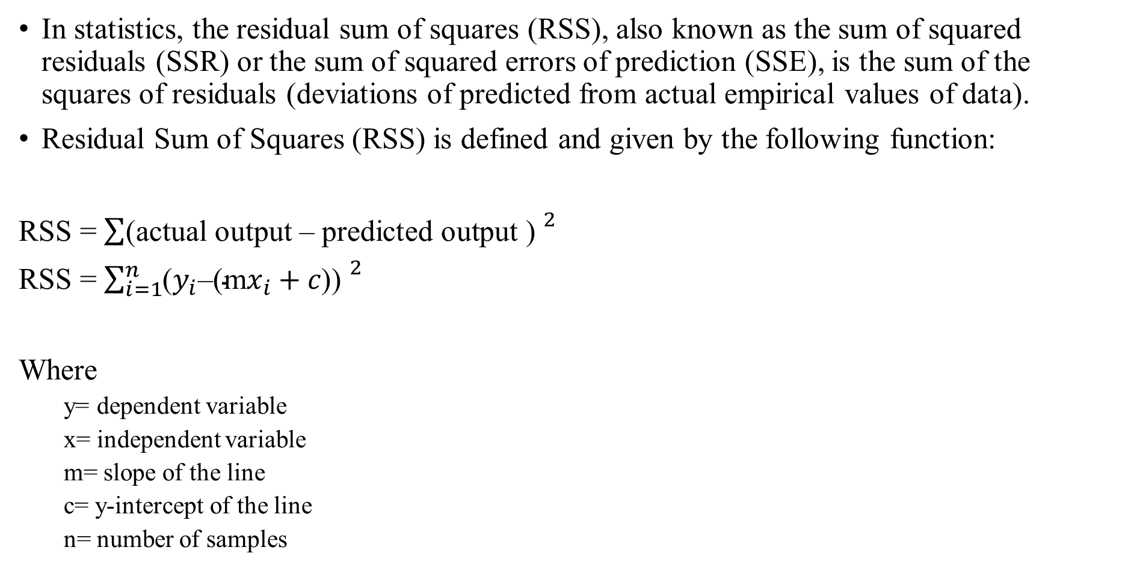
RSS Residual Sum of Squares
In statistics, the residual sum of squares (RSS), also known as the sum of squared residuals (SSR) or the sum of squared errors of prediction (SSE), is the sum of the squares of residuals (deviations of predicted from actual empirical values of data).
Residual Sum of Squares (RSS) is defined and given by the following function:
RSS = $\sum{{\text{(}\text{actual} \text{output}\text{ – }\text{predicted} \text{output}\text{ ) }}^{2}}$
RSS = $\sum_{i=1}^{n}{{\text{(}y_{i}\text{–}\text{(}\text{m}x_{i}+c\text{)}\text{) }}^{2}}$
Where
y= dependent variable
x= independent variable
m= slope of the line
c= y-intercept of the line
n= number of samples

Slide 18
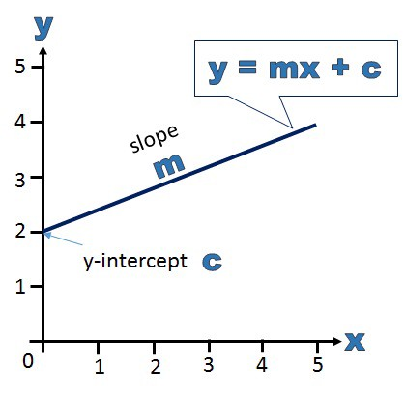
Simple Numerical
Formula for Linear Regression is given by:
y = mx + c
Where
y= dependent variable
x= independent variable
m= slope of the line
c= y-intercept of the line

Slide 19

Simple Numerical
Formula to calculate m and c are given by:
m(slope) = $\frac{ n\sum{xy −(\sum{x})(\sum{y})}}{n\sum{x^{2}} −{(\sum{x})}^{2}}$
c (intercept) = $\frac{\sum{y \sum{x^{2 } − \sum{x \sum{xy}}}}}{\sum{x^{2}} −{(\sum{x})}^{2}}$
Where
y= dependent variable
x= independent variable
m= slope of the line
c= y-intercept of the line
n= number of samples

Slide 20
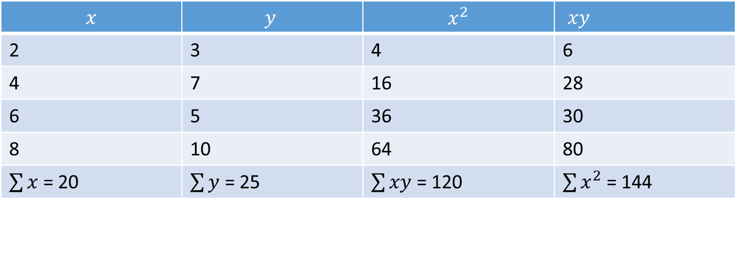
Simple Numerical
Find linear regression equation for the following two sets of data:
Construct the following table:
X | 2 | 4 | 6 | 8
y | 3 | 7 | 5 | 10
$$x$$ | $$y$$ | $$x^{2}$$ | $xy$
2 | 3 | 4 | 6
4 | 7 | 16 | 28
6 | 5 | 36 | 30
8 | 10 | 64 | 80
$\sum{x}$ = 20 | $\sum{y}$ = 25 | $\sum{xy}$ = 120 | $\sum{x^{2}}$ = 144

Slide 21

Simple Numerical
Formula to calculate m and c are given by:
m(slope) = $\frac{ n\sum{xy −(\sum{x})(\sum{y})}}{n\sum{x^{2}} −{(\sum{x})}^{2}}$ = $\frac{ 4 ∗144 −20∗25}{ 4∗120−400}$ = 0.95
c (intercept) = $\frac{\sum{y \sum{x^{2 } − \sum{x \sum{xy}}}}}{\sum{x^{2}} −{(\sum{x})}^{2}}\text{= }\frac{25∗120−20∗144}{4∗120 −400}$ = 1.5
Formula for Linear Regression is given by:
y = mx + c
y = 0.95x + 1.5

Slide 22
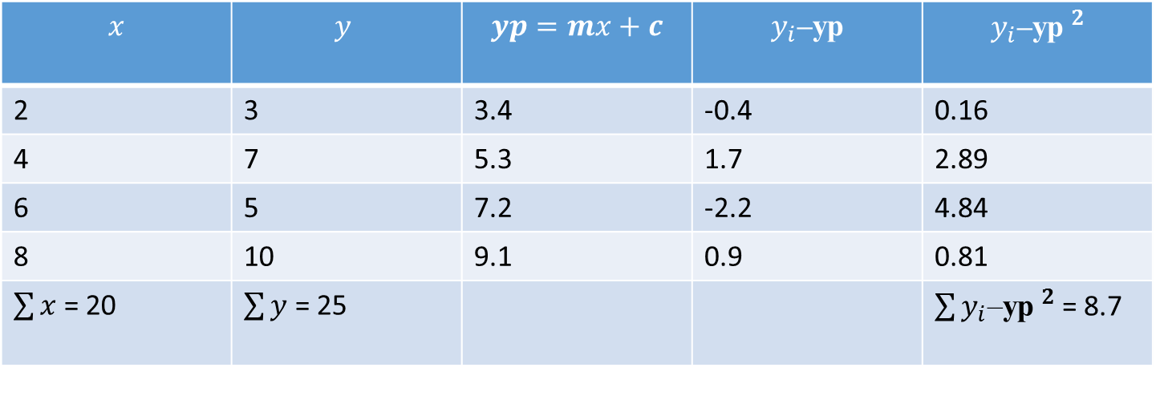

Simple Numerical
Find RSS:
m= 0.95
c= 1.5
RSS = $\sum_{i=1}^{n}{{\text{(}y_{i}\text{–(}\text{m}x_{i}+c\text{)) }}^{2}=8.7}$
X | 2 | 4 | 6 | 8
y | 3 | 7 | 5 | 10
$$x$$ | $$y$$ | $$yp=mx+c$$ | $$y_{i}\text{–}\text{yp}$$ | $${y_{i}\text{–}\text{yp} }^{2}$$
2 | 3 | 3.4 | -0.4 | 0.16
4 | 7 | 5.3 | 1.7 | 2.89
6 | 5 | 7.2 | -2.2 | 4.84
8 | 10 | 9.1 | 0.9 | 0.81
$\sum{x}$ = 20 | $\sum{y}$ = 25 |  |  | $\sum{{y_{i}\text{–}\text{yp} }^{2}}$ = 8.7

Slide 23
Multiple Linear Regression
Multiple linear regression refers to a statistical technique that is used to predict the outcome of a variable based on the value of two or more variables.
It is sometimes known simply as multiple regression, and it is an extension of linear regression.
The variable that we want to predict is known as the dependent variable, while the variables we use to predict the value of the dependent variable are known as independent or explanatory variables.
The technique enables analysts to determine the variation of the model and the relative contribution of each independent variable in the total variance.
Multiple regression can take two forms, i.e., linear regression and non-linear regression.

Slide 24

Multiple Linear Regression
Multiple linear regression formula:
Where:
yi​ is the dependent or predicted variable
β0 is the y-intercept, i.e., the value of y when both xi and x2 are 0.
β1 and β2 are the regression coefficients that represent the change in y relative to a one-unit change in xi1 and xi2, respectively.
βp is the slope coefficient for each independent variable
ϵ is the model’s random error (residual) term.

Slide 25
Multiple Linear Regression-Assumptions
A linear relationship between the dependent and independent variables
The first assumption of multiple linear regression is that there is a linear relationship between the dependent variable and each of the independent variables.
The best way to check the linear relationships is to create scatterplots and then visually inspect the scatterplots for linearity.
If the relationship displayed in the scatterplot is not linear, then the analyst will need to run a non-linear regression or transform the data using statistical software, such as SPSS.
The independent variables are not highly correlated with each other
The data should not show multicollinearity, which occurs when the independent variables are highly correlated to one another.
When independent variables show multicollinearity, there will be problems in figuring out the specific variable that contributes to the variance in the dependent variable.

Slide 26
Multiple Linear Regression-Assumptions
The variance of the residuals is constant
Multiple linear regression assumes that the amount of error in the residuals is similar at each point of the linear model.
When analyzing the data, the analyst should plot the standardized residuals against the predicted values to determine if the points are distributed fairly across all the values of independent variables.
Independence of observation
The model assumes that the observations should be independent of one another.
Simply put, the model assumes that the values of residuals are independent.
Multivariate normality
Multivariate normality occurs when residuals are normally distributed.
To test this assumption, look at how the values of residuals are distributed.
It can also be tested using two main methods, i.e., a histogram with a superimposed normal curve or the Normal Probability Plot method.

Slide 27
Logistic Regression
Logistic Regression was used in the biological sciences in early twentieth century. It was then used in many social science applications.
Logistic Regression is used when the dependent variable(target) is categorical.
For example,
To predict whether an email is spam (1) or (0)
Whether the tumor is malignant (1) or not (0)

Slide 28
Logistic Regression
Consider a scenario where we need to classify whether an email is spam or not.
If we use linear regression for this problem, there is a need for setting up a threshold based on which classification can be done.
Say if the actual class is malignant, predicted continuous value 0.4 and the threshold value is 0.5, the data point will be classified as not malignant which can lead to serious consequence in real time.
From this example, it can be inferred that linear regression is not suitable for classification problem. Linear regression is unbounded, and this brings logistic regression into picture. Their value strictly ranges from 0 to 1.

Slide 29
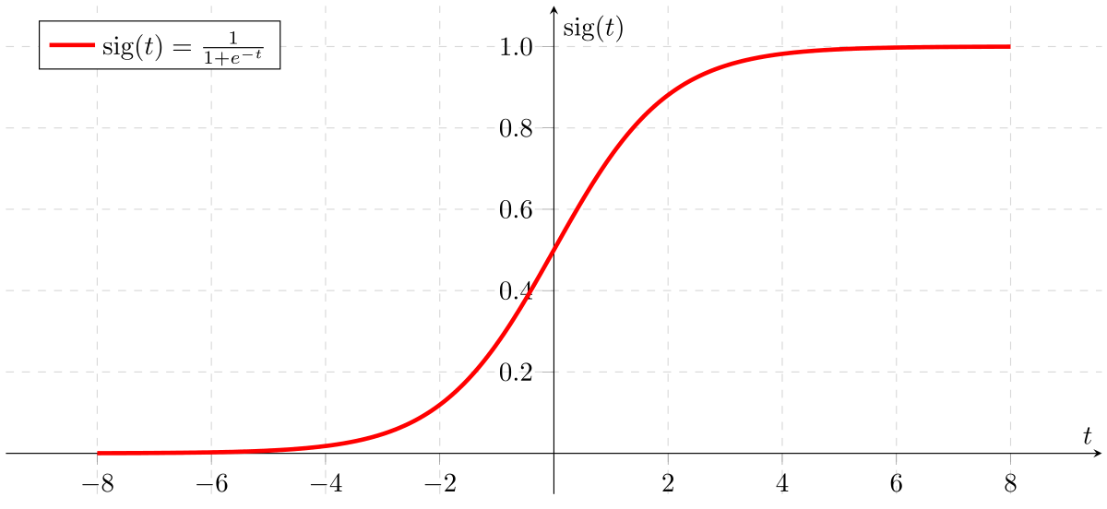
Model
Output = 0 or 1
Hypothesis => Z = WX + B
hΘ(x) = sigmoid (Z)
If ‘Z’ goes to infinity, Y(predicted) will become 1 and if ‘Z’ goes to negative infinity, Y(predicted) will become 0.

Slide 30
Logistic Regression-types
1. Binary Logistic Regression
The categorical response has only two 2 possible outcomes. Example: Spam or Not
2. Multinomial Logistic Regression
Three or more categories without ordering. Example: Predicting which food is preferred more (Veg, Non-Veg, Vegan)
3. Ordinal Logistic Regression
Three or more categories with ordering. Example: Movie rating from 1 to 5

Slide 31
Decision Boundary
To predict which class a data belongs, a threshold can be set.
Based upon this threshold, the obtained estimated probability is classified into classes.
Say, if predicted_value ≥ 0.5, then classify email as spam else as not spam.
Decision boundary can be linear or non-linear.
Polynomial order can be increased to get complex decision boundary.

Slide 32
References
Books and Journals
Understanding Machine Learning: From Theory to Algorithms by Shai Shalev-Shwartz and Shai Ben-David-Cambridge University Press 2014
Introduction to machine Learning – the Wikipedia Guide by Osman Omer.
Video Link-
https://www.youtube.com/watch?v=9f-GarcDY58
https://www.youtube.com/watch?v=GwIo3gDZCVQ
Web Link-
https://towardsdatascience.com/data-science-simplified-simple-linear-regression-models-3a97811a6a3d
https://www.nku.edu/~statistics/Simple_Linear_Regression.htm
https://towardsdatascience.com/logistic-regression-detailed-overview-46c4da4303bc

Slide 33
THANK YOU

